Slide 1

CHURN RATE PREDICTION
https://www.kaggle.com/blastchar/telco-customer-churn
CAHYA PUTERA P
JCDS8

Slide 2

PROBLEM
Customer churn is one of the most important metrics for a growing business to evaluate.
While it's not the happiest measure, it's a number that can give your company the hard truth about its customer retention.

Slide 3
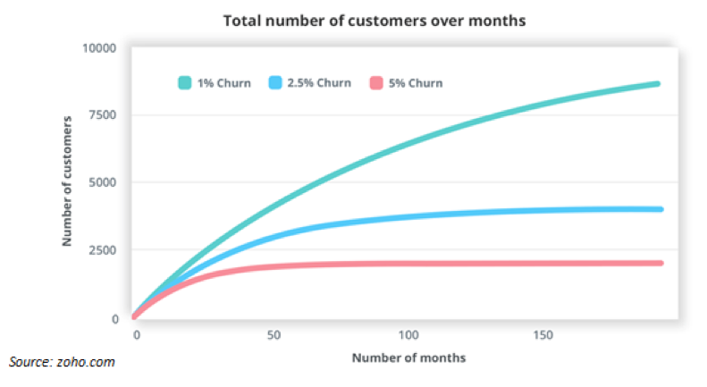
What Is The Impact ?
According to a study by Kolsky, when churn rate is high, it can affect the decisions you make for your business as well as your revenue. As 1 in 26 unhappy customers will complain, the rest will churn.
And Zoho.com revealed that the higher your churn rate, the bigger the negative impact will be on your business.

Slide 4
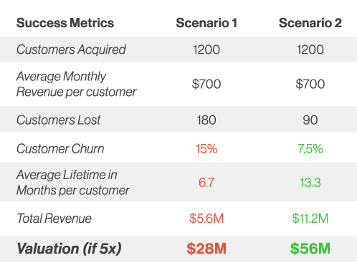
Why Should It Be Prioritized ?
Churn is one of the few metrics that can be directly correlated to revenue.
If your customer churn rate is higher than your new customer acquisition rate, your business will struggle.
The table on the right, illustrating the impact of churn rate on revenue and valuation.

Slide 5

CHURN ?

Slide 6
What Is Churn Rate ?
Investopedia defines churn rate as “the percentage of subscribers to a service who discontinue their subscriptions to that service within a given time period.”
You can calculate it by dividing the number of customers you lost during that time period, by the number of customers you had at the beginning of that time period.
For example, if you start your quarter with 400 customers and end with 380, your churn rate is 5% because you lost 5% of your customers.
Obviously, your company should aim for a churn rate that is as close to 0% as possible. In order to do this, your company has to be on top of its churn rate at all times and treat it as a top priority.

Slide 7
Why The Customers Churning ?
Lack of (or Zero) Engagement
Poor Product-Market Fit
Product Bugginess
Difficult User Experience
Lack of Proactive Support
Business Competitors

Slide 8

Data Scientist Role ?
A Data Scientist prediction could help the company especially to spot the customers who will be churned.
This is important, because it costs more to acquire new customers than it does to retain existing customers.
As a result, your company can spend less on the operating costs of having to acquire new customers.
In fact, an increase in customer retention of just 5% can create at least a 25% increase in profit.

Slide 9

DATASET ?
Data used are from the IBM Watson Repository - Sample Datasets for Customer Retention Programs.
Dataset contains 7043 rows and 20 variables, including the target (‘Churn’).
https://github.com/IBM/customer-churn-prediction

Slide 10

OBJECTIVE ?
To predict customer’s churn
Highlighting the variables influencing churn
Build prediction model
Choose best model to predict based on it’s recall
Apply and test the model into dashboard

Slide 11
PROJECT MODEL PREDICTION FLOW
OVERVIEW & DATA PREPROCESSING
MODEL BUILDING
FEATURE SELECTION & MODEL DEPLOYMENT
HYPER
EXPLORATORY DATA ANALYSIS
LABELLING & SCALING
DASHBOARD

Slide 12

CONCLUSION
Lean to your best customers
Define roadmap for new customer
Offer a better services for the indicated churn customer
Ask for feedback and suggestion regularly
Offer incentives and such, to stay competitive with the competitors

Slide 13

Thank You

